Slide 1

tulsaschoolofdev.com
tulsadevelopers.net

Slide 2



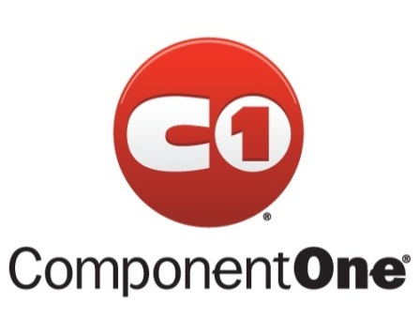










Sponsors

Slide 3
Intro to Object Relational Mappers with Entity Framework
Devlin Liles
Tim Rayburn

Slide 4
Devlin Liles
Principal Consultant Improving Enterprises
Data Platform Development MVP
Author – Entity Framework 4.1 Expert’s Cookbook
Passionate Technologist

Slide 5
Tim Rayburn
Principal Consultant Improving Enterprises
Connected Systems MVP
Author – Entity Framework 4.1 Expert’s Cookbook
Passionate Technologist

Slide 6
Questions we are going to answer
What is the problem we are trying to solve?
What does this problem cost us?
What is an Object Relational Mapper?
How does an ORM solve the problem?
What are the drawbacks?

Slide 7
The Problem
Most modern development is done using class-based, object-oriented languages.
Most storage in modern development is done using Relational Database Management Systems or ( RDBMS )
Most objects translate poorly into properly formatted relational models.

Slide 8
Discussion
Is that really a problem?
Is it going to change?
How do we normally deal with this?
Can we do it better?

Slide 9
The Costs
Coding this is time consuming.
Highly repetitive.
Error prone.
In short this problem costs us and our employers “MONEY”

Slide 10
Silver Bullet? No, brass maybe
Object Relational Mappers do one thing.
Mapping Relational table(s) into Domain Object(s)
That is it…. Everything else is not part of the ORM.
This is to make our lives easier when dealing with talking to the Database

Slide 11
Language Integrated Query
Standardized language for dealing with all kinds of data.
Composable
Reusable
Defered

Slide 12
The good, bad, and ….
We can write bad SQL with any ORM
We have to pay attention
We have to “CARE”

Slide 13
The draw backs
We lose direct control over the SQL generated
We accept some standard practices that may differ from our normal approach.
We have new things we have to care about.

